Slide 1
JAVA Programming Language LESSON 15: Input/Output Stream
KANIMBA PATRICK
IPRC SOUTH
ICT Department

Slide 2
The eight core packages of Java
java.awt
java.awt.event
java.io
java.sql
java.net
java.util
java.lang
java.applet

Slide 3
Outline
Streams
Byte Streams
Character Streams
Files
Object Serializing
Summary

Slide 4
Streams

Slide 5
What is stream
A stream is a path of communication between the source of some information and its destination.
That information, an uninterpreted byte stream, can come from any “pipe source,” the computer’s memory, or even from the Internet.

Slide 6
The features of streams
The source and destination of a stream are completely arbitrary producers and consumers of bytes, respectively.
You don’t need to know about the source of the information when reading from a stream
You don’t need to know about the final destination when writing to one.

Slide 7
The streaming processing methods
General-purpose methods that can read from any source accept a stream argument to specify that source
General methods for writing accept a stream to specify the destination.
Arbitrary processors (or filters) of data have two stream arguments. They read from the first, process the data, and write the results to the second.

Slide 8
The stream framework of Java
At the pinnacle of the byte stream framework are the two abstract classes, InputStream and OutputStream.
The two basic abstract class of character stream are Reader and Writer.
Any I/O errors throw instances of IOException, no errors.

Slide 9
Streams associated with devices
Java can associates streams of bytes associated with devices.
In fact, Java creates three stream objects that are associated with devices when a Java program begins executing:
System.in, System.out and System.err
Each of these streams can be redirected.
setIn, setOut and setErr

Slide 10
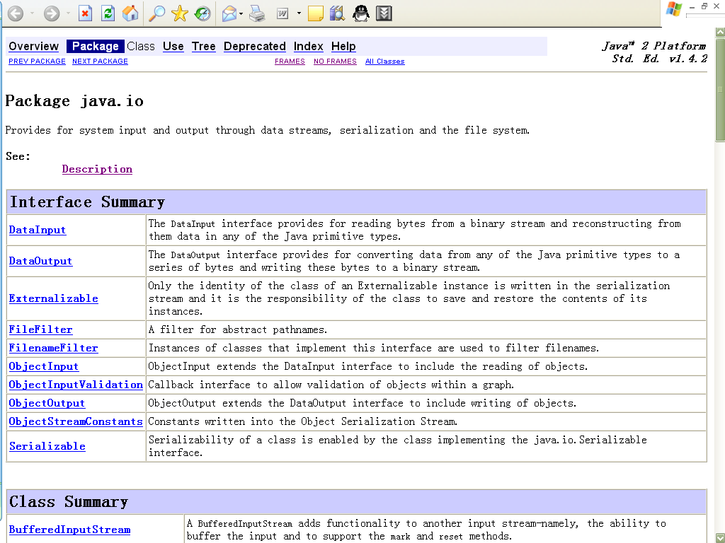
The package java.io

Slide 11
Byte Streams

Slide 12
The abstract class InputStream
InputStream is an abstract class that defines the fundamental ways in which a destination consumer reads a stream of bytes from some source.
When using an input stream, you are the destination of those bytes, and that’s all you need to know.
InputStream
+ available + close + mark(int readlimit) + markSupported + read + read(byte[] b) + read(byte[]b, int off, int len) + reset() + skip(long n)

Slide 13
InputStream class hierarchy

Slide 14
Sample code
import java.io.*; /** * @author Patty * */ public class InputStreamTest { public static void main(String[] args) throws IOException { InputStream is; is = System.in; byte[] b = new byte[6]; | is.read(b); is.mark(6); System.out.println(new String(b)); }//main() }/* InputStream */
 | Input: Hello! Output: Hello!

Slide 15
The abstract class OutputStream
OutputStream is the abstract class that defines the fundamental ways in which a source (producer) writes a stream of bytes to some destination.
When using an output stream, you are the source of those bytes, and that’s all you need to know.
OutputStream
+ close() + flush() + write(byte[] b) + write(byte[] b, int off, int len) + write(int b)

Slide 16
OutputStream class hierarchy

Slide 17
Sample code
import java.io.*; /** * @author Patty * */ public class OutputStreamTest { public static void main(String[] args) throws IOException { OutputStream os = System.out; byte[] b = {'H', 'e', 'l', 'l', 'o', '!'}; | os.write(b); os.flush(); }//main() }/* OutputStreamTest */
 | Output: Hello!

Slide 18
DataInputStream
DataInputStreams enable a program to read binary data from an InputStream.
The DataInput interface includes methods:
read (for byte arrays)
readBoolean, readByte, readChar
readDouble, readFloat, readFully (for byte arrays)
readInt, readLong, readShort, readUnsignedByte, readUnsignedShort
readUTF (for strings) and skipBytes

Slide 19
Sample code
import java.io.*; /** * @author Patty * */ public class DataInputStreamTest { public static void main(String[] args) throws IOException { DataInputStream dis = new DataInputStream(System.in); byte[] b = new byte[10]; dis.read(b); | dis.mark(b.length); for(int i = b.length; i > 0; i--) System.out.print((char)b[i - 1]); }//main() }/* DataInputStreamTest */
Intput:
0123456789
Output:
9876543210

Slide 20
DataOutputStream
DataOutputStreams enable a program to write binary data to an OutputStream
The DataOutput interface includes methods
flush, size, write (for a byte), write (for a byte array),
writeBoolean
writeByte, writeBytes, writeChar, writeChars (for Unicode Strings)
writeDouble, writeFloat, writeInt, writeLong, writeShort
writeUTF

Slide 21
Sample code
import java.io.*; /** * @author Patty * */ public class DataOutputStreamTest { public static void main(String[] args) throws IOException { DataOutputStream dos = new DataOutputStream(System.out); | byte[] b = {'H', 'e', 'l', 'l', 'o', '!'}; dos.write(b); System.out.println(); dos.writeBytes("Hello!"); dos.flush(); }//main() }/* DataOutputStreamTest */
 | Output: Hello!

Slide 22
Character Stream

Slide 23
The change of Java I/O
There is a significant change in the I/O library after Java 1.0, when the original byte-oriented library is supplemented with char-oriented, Unicode-based I/O classes.
In JDK 1.4, the new I/O classes were added for improved performance and functionality.

Slide 24
Two key classes
The two key classes of character stream are Reader and Writer.
InputStreamReader converts an InputStream to a Reader
OutputStreamWriter converts an OutputStream to Writer

Slide 25
The features of character stream
The most important reason for the Reader and Writer hierarchies is for internationalization.
The old I/O stream hierarchy supports only 8-bit byte streams and doesn’t handle the 16-bit Unicode characters well.
The Reader and Writer hierarchies were added to support Unicode in all I/O operations.
In addition, the new libraries are designed for faster operations than the old.

Slide 26
Character stream vs. byte stream
Byte stream | Character stream
InputStream | Reader adapter: InputStreamReader
OutputStream | Writer adapter: OutputStreamWriter
FileInputStream | FileReader
FileOutputStream | FileWriter
StringBufferInputStream | StringReader
(no corresponding class) | StringWriter
ByteArrayInputStream | CharArrayReader
ByteArrayOutputStream | CharArrayWriter
PipedInputStream | PipedReader
PipedOutputStream | PipedWriter

Slide 27
Sample code
import java.io.*; /** * @author Patty * */ public class DataOutputStreamAndBufferedWriter { public static void main(String[] args) throws IOException { String str = “ICT209, Java!"; DataOutputStream dos = new DataOutputStream(System.out); dos.writeBytes(str); dos.flush(); System.out.println(); | BufferedWriter bw = new BufferedWriter(new OutputStreamWriter(System.out)); bw.write(str); bw.flush(); }//main() }/* DataOutputStreamAndPrintWriter */
Output:
`}, Java!
ICT209, Java!

Slide 28
Sample code
import java.io.*; /** * @author Patty * */ public class StringEncoder { public static void main(String[] args) throws IOException { String str = “ICT209, Java!"; DataOutputStream dos = new DataOutputStream(System.out); byte b[] = str.getBytes(); | str = new String(b, "ISO-8859-1"); dos.writeBytes(str); dos.flush(); }//main() }/* StringEncoder */
 | Output: ICT209, Java!

Slide 29
Console Input
Read string from the keyboard
InputStreamReader
BufferedReader

Slide 30
Sample code
import java.io.*; /** * @author Patty * */ public class ConsoleInputTest { public static void main(String[] args) throws IOException { String strOutput = ""; while(true) { String strTemp = new BufferedReader(new InputStreamReader(System.in)).readLine(); if(strTemp.equals("stop")) | break; else strOutput += strTemp + "\n"; }//while System.out.println(strOutput); }//main() }/* ConsoleInputTest */
 | Input: abcd efgh stop Output: abcd efgh

Slide 31
Files

Slide 32
The file class
The File class has a deceiving name; you might think it refers to a file, but it doesn’t.
In face, it can represent either the name of a particular file or the names of a set of files in a directory.
In other word, a directory is also a file.

Slide 33
Sample code
import java.io.*; /** * @author Patty * */ public class FileLister { public static void main(String[] args) { File file = new File(".\\lesson6"); String[] strFileNames = file.list(); for(int i = 0; i < strFileNames.length; i++) System.out.println(strFileNames[i]); }//main() }/* FileLister */ | Output: ConsoleInputTest.class ConsoleInputTest.java DataInputStreamTest.class DataInputStreamTest.java DataOutputStreamAndBufferedWriter.class DataOutputStreamAndBufferedWriter.java DataOutputStreamTest.class DataOutputStreamTest.java FileLister.class FileLister.java InputStreamTest.class InputStreamTest.java OutputStreamTest.class OutputStreamTest.java StringEncoder.class StringEncoder.java

Slide 34
Sample code
import java.io.*; /** * @author Patty * */ public class FileLister_DOS { public static void main( String[] args ) { String[] strFiles = new File(".").list(); for ( int i = 0; i < strFiles.length; i ++ ) { System.out.print( new File( strFiles[i] ).isDirectory() ? "[" : "" ); | System.out.print( strFiles[i] ); System.out.println( new File( strFiles[i] ).isDirectory() ? "]" : "" ); }//for }//main() }/* FileListTest */
 | Output: .classpath .project HelloWorld.class HelloWorld.java [lesson1] [lesson2] [lesson3] [lesson4] [lesson5] [lesson6] NewFile Test1.class Test1.java

Slide 35
FileInputStream
One of the most common uses of streams, and historically the earliest, is to attach them to files in the file system.
Read content from a file

Slide 36
Sample code
/** * @author Patty * */ public class FileInputStreamTest { public static void main(String[] args) throws IOException { FileInputStream fis = new FileInputStream(".\\lesson6\\FileInputStreamTest.java"); File file = new File(".\\lesson6\\FileInputStreamTest.java"); System.out.println(file.exists()); | for(long l = 0; l < file.length(); l++) System.out.print((char)fis.read()); }//main() }/* FileInputStreamTest */
 | Output: true /* * Created on 2005-5-9 * */ package lesson6; import java.io.*; /** * @author Wu Di * */ public class FileInputStreamTest { public static void main(String[] args) throws IOException { FileInputStream fis = new FileInputStream(".\\lesson6\\FileInputStreamTest.java"); File file = new File(".\\lesson6\\FileInputStreamTest.java"); System.out.println(file.exists()); for(long l = 0; l < file.length(); l++) System.out.print((char)fis.read()); }//main() }/* FileInputStreamTest */

Slide 37
FileOutputStream
Class FileOutputStream provides methods for writing byte arrays and individual bytes to a file.
Create files
Create directories
Write content to a file

Slide 38
Sample code
import java.io.*; /** * @author Patty * */ public class FileOutputStreamTest { public static void main(String[] args) throws IOException { FileOutputStream fos = new FileOutputStream(".\\lesson6\\test.dat"); byte[] b = {'H', 'e', 'l', 'l', 'o', '!'}; fos.write(b); FileInputStream fis = new FileInputStream(".\\lesson6\\test.dat"); int i; | while((i = fis.read()) != -1) System.out.print((char)i); fis.close(); fos.close(); new File(".\\lesson6\\test.dat").delete(); }//main() }/* FileOutputStreamTest */
 | Output: Hello!

Slide 39
Sample code
import java.io.*; /** * @author Patty * */ public class FileCreation { public static void main(String[] args) throws IOException { File fileNewFile = new File("./lesson6/NewFile"); if (fileNewFile.createNewFile()) System.out.println("文件创建成功！"); File fileNewDir = new File("./lesson6/NewDir"); | if (fileNewDir.mkdir()) System.out.println("目录创建成功！"); File fileNewDirs = new File("./lesson6/NewDir1/NewDir2/NewDir3"); if (fileNewDirs.mkdirs()) System.out.println("多层目录创建成功！"); System.out.println(File.separator); }//main() }/* FileCreation */

Slide 40
Data I/O
Use Datainputstream and DataOutputStream to access files.

Slide 41
Sample code
import java.io.*; /** * @author Patty * */ class DataIOTest { public static void main(String args[]) throws IOException { DataOutputStream dos = new DataOutputStream(new FileOutputStream( "temp.dat")); dos.writeBoolean(true); dos.writeByte((byte) 35); | dos.writeChar('A'); dos.writeDouble(3.1415926); dos.writeFloat(3.14F); dos.writeInt(123456789); dos.writeLong(9876543210L); dos.writeShort((short) 1024); dos.close(); DataInputStream dis = new DataInputStream(new FileInputStream( "temp.dat")); System.out.println("\t " + dis.readBoolean()); System.out.println("\t " + dis.readByte());

Slide 42
Sample code
System.out.println("\t " + dis.readChar()); System.out.println("\t " + dis.readDouble()); System.out.println("\t " + dis.readFloat()); System.out.println("\t " + dis.readInt()); System.out.println("\t " + dis.readLong()); System.out.println("\t " + dis.readShort()); dis.close(); new File("temp.dat").delete(); }//main() }/* DataIOTest */ | Output: true 35 A 3.1415926 3.14 123456789 9876543210 1024

Slide 43
Random-access file
A RandomAccessFile is created given a file, a filename, or a file descriptor.
It combines in one class implementations of the DataInput and DataOutput interfaces, both tuned for “random access” to a file in the file system.

Slide 44
Sample code
import java.io.*; /** * @author Patty * */ public class RandomAccessFileTest { public static void main(String[] args) throws IOException, FileNotFoundException { RandomAccessFile raf = new RandomAccessFile("temp.dat", "rw"); //write data for (int i = 0; i < 10; i++) raf.writeInt(i); | //read data for (int i = 0; i < 10; i++) { raf.seek(i * 4); //the size of int is 4 System.out.print(raf.readInt() + " "); }//for //close the random access stream raf.close(); //delete temporary file new File("temp.dat").delete(); }//main() }/* RandomAccessFileTest */
 | Output: 0 1 2 3 4 5 6 7 8 9

Slide 45
File separator
The system-dependent default name-separator character.
Different OS has different separator.

Slide 46
Sample code
import java.io.*; /** * @author Patty * */ public class FileSeparator { public static void main(String[] args) { File file = new File("." + File.separator + "lesson6"); String[] strFileNames = file.list(); for(int i = 0; i < strFileNames.length; i++) System.out.println(strFileNames[i]); }//main() }/* FileSeparator */ | Output: ConsoleInputTest.class ConsoleInputTest.java DataInputStreamTest.class DataInputStreamTest.java DataOutputStreamAndBufferedWriter.class DataOutputStreamAndBufferedWriter.java DataOutputStreamTest.class DataOutputStreamTest.java FileLister.class FileLister.java InputStreamTest.class InputStreamTest.java OutputStreamTest.class OutputStreamTest.java StringEncoder.class StringEncoder.java

Slide 47
Object serializing

Slide 48
Sample code
import java.io.*; /** * @author Patty * */ public class ObjectSerializing { public static void main(String[] args) throws Exception { class Cat implements Serializable { String strName; int intAge; Cat(String strInputName, int intInputAge) { strName = strInputName; | intAge = intInputAge; }//Cat() public String toString() { return "{姓名：" + strName + "\t年龄：" + intAge + "}"; }//toString() }/* Cat */ //create objects Cat catWhite = new Cat("TOM", 4); Cat catBlack = new Cat("Peter", 3);

Slide 49
Sample code
//store objects ObjectOutputStream oosMain = new ObjectOutputStream( new FileOutputStream("cat.dat")); oosMain.writeObject(catWhite); oosMain.writeObject(catBlack); oosMain.close(); //retrieve objects ObjectInputStream oisMain = new ObjectInputStream(new FileInputStream( "cat.dat")); System.out.println(((Cat) oisMain.readObject()).toString()); | System.out.println(((Cat) oisMain.readObject()).toString()); oisMain.close(); }//main() }/* ObjectSerializing */
 | Output: {姓名：TOM年龄：4} {姓名：Peter年龄：3}

Slide 50
Thanks

